Slide 1
Parallel and distributed processing of big data Elioz Geller & Yanir Avitan Functional programming in concurrent and distributed systems course Lecturer's name -Dr. Yehuda Ben-Shimol Practitioner's name -Mr. David Leon Ben GurionUniversity, Beer Sheva, ISRAEL

Slide 2
About
In this project we will use map reduce to analyze big data in parallel and distributed systems with Erlang programming language.
This program analyze big data from www.dblp.org and create tree of the partners for the author that the user chooses. In addition this program displays a table of the number of surnames beginning with the same letter at each level in the tree.

Slide 3
How it works
The master assigns responsibility to workers for certain letters.
The master divides the files between the computers.
Each computer processes its part and transmits the data to the computer responsible on this author.
After the processing done the program wait for input from the user.
After the input, the data from the computer responsible on each researcher is requested in a parallel and recursive way.

Slide 4
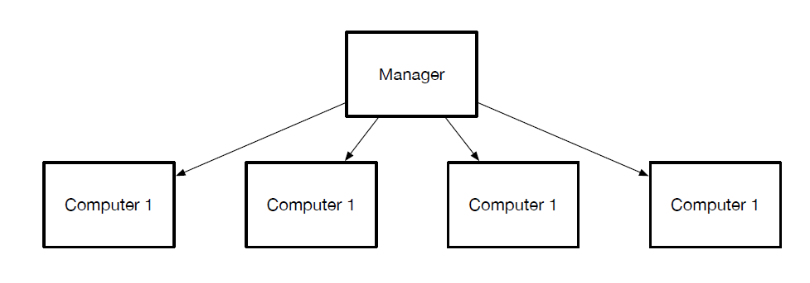
Multiple computers
Our software is unlimited in the number of computers that will participate in the process.

Slide 5
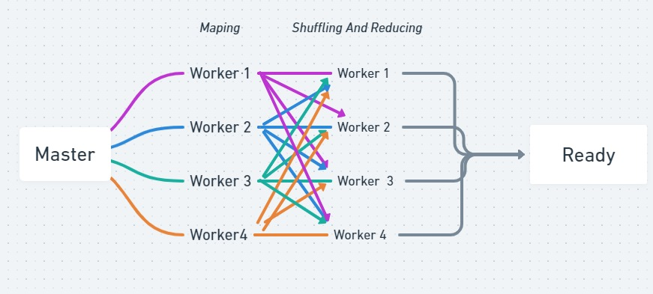
MapReduce - Processing stage

Slide 6
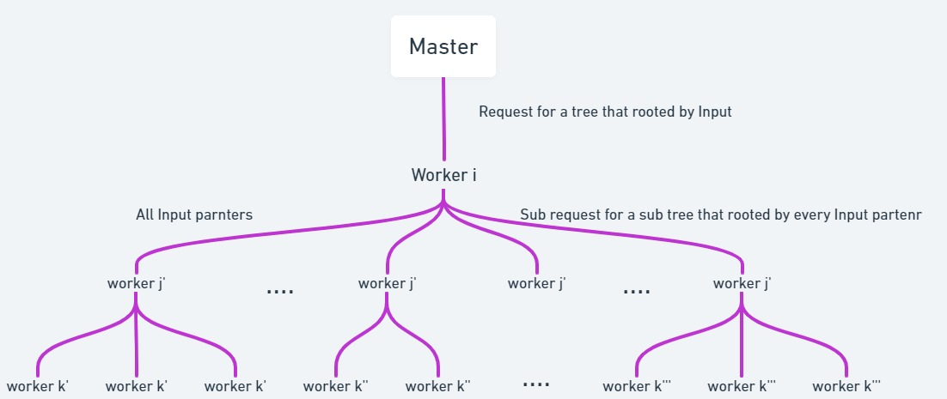
Tree construct stage

Slide 7
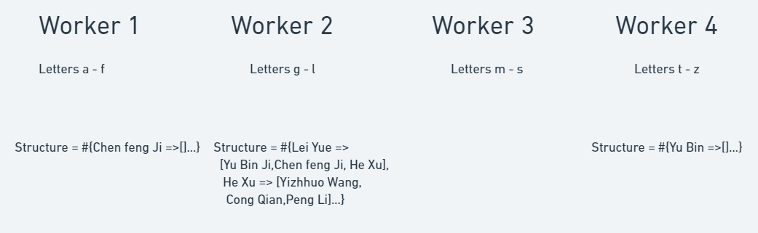
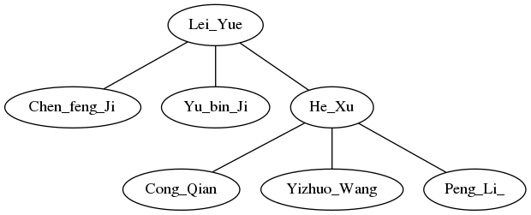
Tree construct stage - example

Slide 8
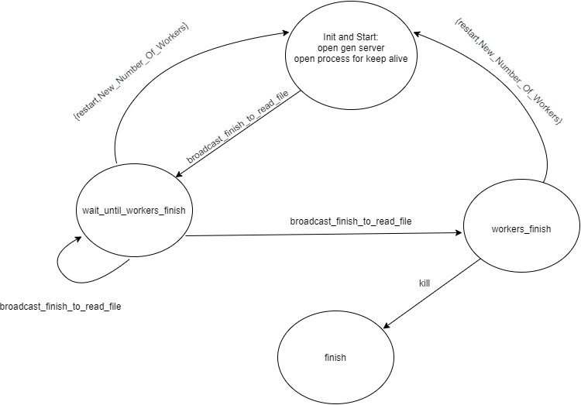
Master - state machine
Init and start
Wait to workers
Workers finish to process
Finish
Data structure = {Number_Of_Workers,Count_Start,Count_Broadcast,{Frame,Text}}

Slide 9
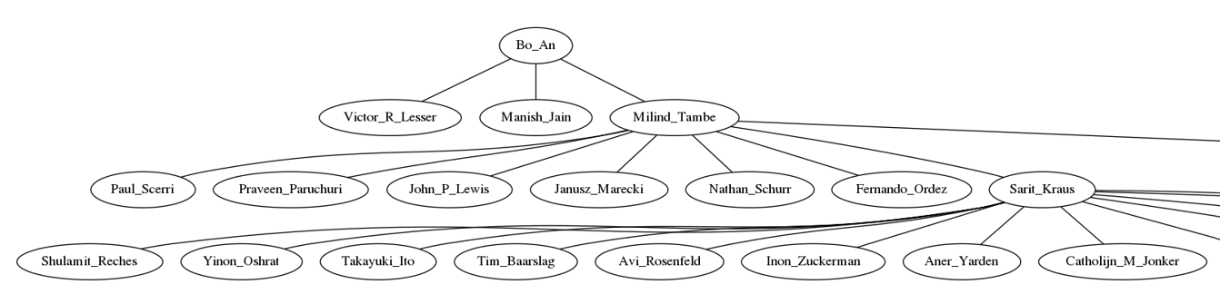
Dynamic code
There is no limit to the amount of computers that can participate in processing.
There is a DEFINE to control the depth of the tree we get.

Slide 10
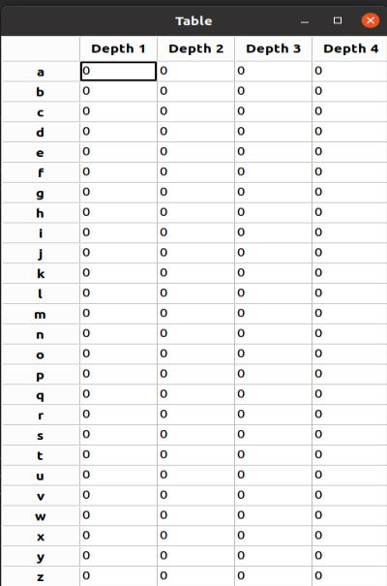
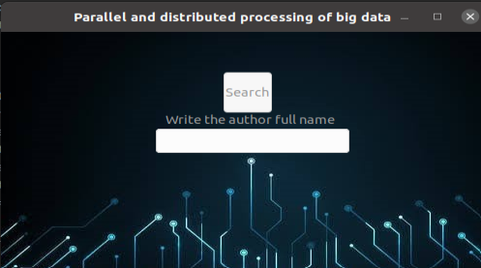
GUI
Simple interface for users.

Slide 11
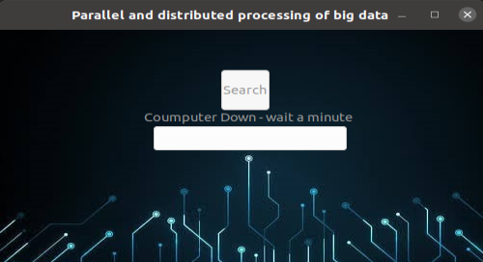
Keep alive
The master constantly checks how many computers are running with keep-alive message.
If a computer crashes, the master change the responsibility of the computer that crashed to another computer.

Slide 12
Statistics - Processing stage
 | Average time after 20 test
1 computer 1 worker | 4.7475 sec
1 computer 4 workers | 4.8825 sec
5 computers 4 workers | 4.79 sec
As the size of the big data increases, it will be better to process with a large number of computers.
As the size of the big data decreases, network messaging time will be more significant.

Slide 13
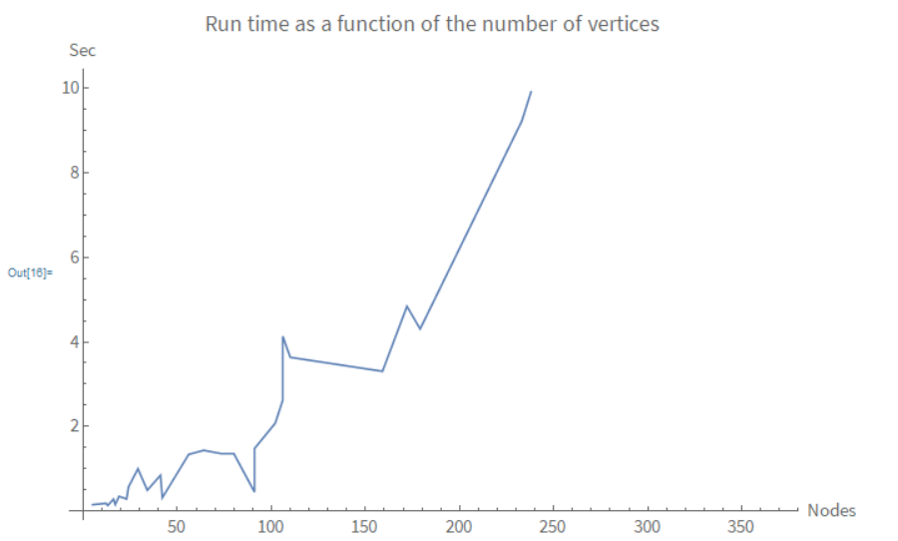
Statistics - Tree construct stage
Number of nodes - pc1 | Number of nodes - pc2 | Number of nodes - pc3 | Number of nodes - pc4 | Number of nodes in result | Average time [sec]
4 | 5 | 5 | 5 | 19 | 0.347658
10 | 16 | 24 | 14 | 64 | 1.437036
0 | 5 | 0 | 0 | 5 | 0.152049
5 | 39 | 35 | 27 | 106 | 2.62173
0 | 4 | 4 | 4 | 12 | 0.183969
5 | 8 | 9 | 12 | 34 | 0.494069
5 | 14 | 15 | 7 | 41 | 0.845886
7 | 6 | 4 | 6 | 23 | 0.287291
0 | 5 | 4 | 7 | 16 | 0.28002
0 | 6 | 11 | 7 | 24 | 0.56946
39 | 45 | 64 | 31 | 179 | 4.306796
206 | 182 | 241 | 143 | 772 | 85.098412
4 | 73 | 5 | 9 | 91 | 0.449196
24 | 25 | 50 | 73 | 172 | 4.842396
37 | 15 | 33 | 17 | 102 | 2.07836
5 | 0 | 8 | 16 | 29 | 0.998763
4 | 0 | 4 | 5 | 13 | 0.134736
8 | 0 | 4 | 5 | 17 | 0.155572
9 | 7 | 22 | 4 | 42 | 0.315998
14 | 17 | 22 | 20 | 73 | 1.361206
0 | 17 | 19 | 20 | 56 | 1.340326
0 | 17 | 45 | 29 | 91 | 1.47988
0 | 45 | 93 | 21 | 159 | 3.305386
111 | 51 | 18 | 53 | 233 | 9.222754
14 | 13 | 38 | 15 | 80 | 1.356621
30 | 23 | 42 | 15 | 110 | 3.635366
48 | 26 | 4 | 28 | 106 | 4.133644

Slide 14
Youtube & GitHub
Link for Youtube video:
https://www.youtube.com/watch?v=7HWlEaO4jUk
Link for Github project:
https://github.com/yanir26/Parallel-and-distributed-processing-of-big-data

Slide 15
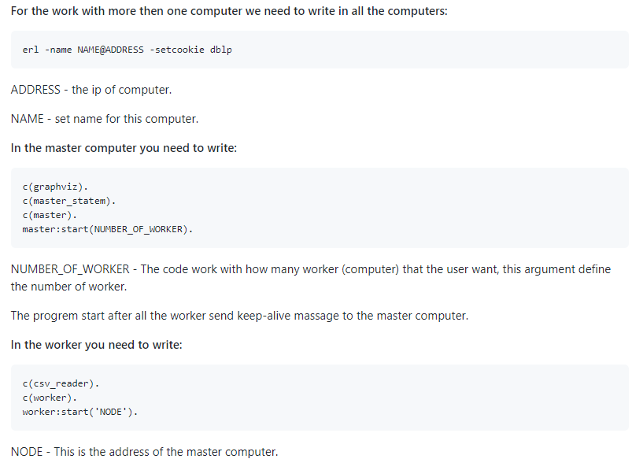
How to run the program

Slide 16
thanks for listening any questions ?

